Slide 1
Presenting your data science project
Tips and tricks to help you give a great presentation

Slide 2
Presentation Flow
Give the context of the project - What is the big question you are investigating and some hypothesis about that question.
Show a preview of the results - Give them enough to keep their interest throughout the more difficult parts of the presentation.
Familiarize the dataset - Share relevant parts of your EDA.
Outline the process - How did you go about getting your results?
Deep dive of the results - Help them understand how good your model is or why it isn’t great.
Real world application - Who can use your model and how would they use it?

Slide 3
Setting up the Context
What is the big question/problem?
How did this translate to a specific data science question?
What is your overall goal?
What data did you use?
What hypothesis do you have about the data? (Do you think some variables will be more important than other ones?)

Slide 4
The Problem of “fedspeak”
FOR EXAMPLE
“Fedspeak” is the term given to the “turgid dialect of English” used by the Federal Reserve Board chairmen - the Fed is known to make wordy, vague and ambiguous statements.
Whenever the Fed talks, financiers listen - often qualitatively combing over the Fed's word choice.
Can we use NLP to draw insights about the Fed’s topics of interest in a quantitative way instead?

Slide 5
Show them a preview of the results
By showing your results at the beginning, you can help to keep the audience intrigued throughout the tougher parts of the presentation.
“I was able to predict the number of daily customers at the cafeteria within 5% accuracy of the actual number.”
“Predicting the number of customers every day is difficult, but we did identify some important variables that can help us reduce waste.”
This is not a deep dive of the results, just enough to whet their appetite.

Slide 6
Describe the Process
Data Pipeline
Data Cleaning
SQL
Data Visualizations.
The depth in which you dive into each of these depends on your audience, the amount of time you have, and them impact it has on your data story.
A great place to show the different technical tools and skill you utilized during the project.

Slide 7





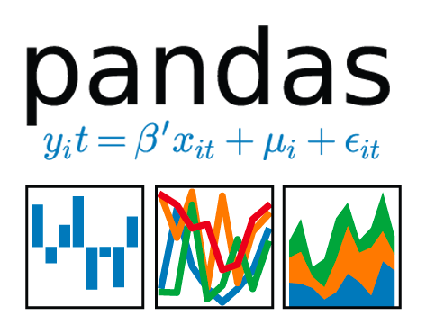




Process
Analysis
plotly
LDA Model
LDA Visualization
Cleaning
T-SNE Clustering
EVALUATION
Tokenize Lemmatize
Gather: Twint
8 Domestic Airlines
FOR EXAMPLE

Slide 8

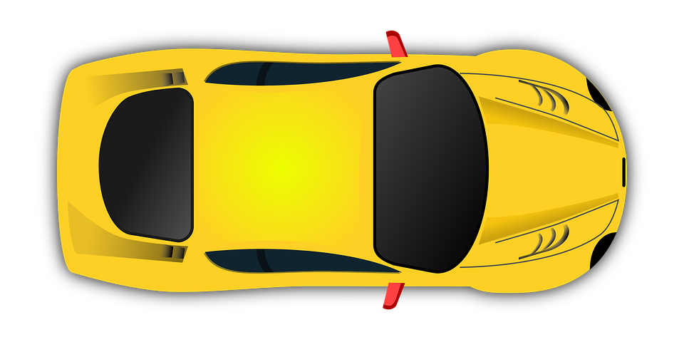
PROCESS
OUTLINE
Neighborhood
NYC
First models
Visualization
Data Gathering
Borough
Exogenous
variables
Data Study
FOR EXAMPLE
Forecasts for 103 locations
FB Prophet models with exog variables
Facebook Prophet S/ARIMA
Streamlit visualization dashboard
Taxi - NYC open data Weather - NOAA Bikes - CityBike NYC
Separate models per each borough
US holidays weather bike demand
Dataset exploration

Slide 9
Dive into the data
First let us know about your data:
Where did you get it?
How larges is your data set?
What are you variables of interest?
Then go through important EDA graphics to help the audience become more familiar with the data:
Any big data cleaning steps that will greatly impact your model
Distributions plot of the target variables
Highlight variables that domain knowledge makes you believe are important
Everything that you go over in this step should contribute to the overall data story. Don’t tell us about a random variable unless it is important to that story.

Slide 10








Data – Twitter
FOR EXAMPLE
Collected over 110,000 tweets using Twint
Twint - Web scraping tool
2018-2019
4 Major Airlines
United Airlines
American Airlines
Delta Air Lines
Alaska Airlines
4 Low-Cost Carrier Airlines
Southwest Airlines (largest low-cost carrier)
JetBlue
Frontier (ultra low-cost carrier)
Spirit Airlines (ultra low-cost carrier)

Slide 11
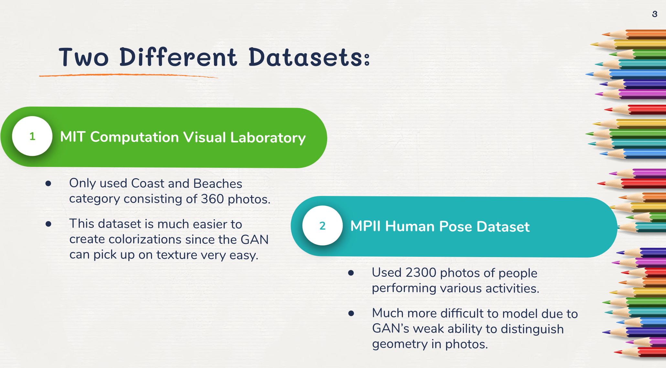
FOR EXAMPLE

Slide 12
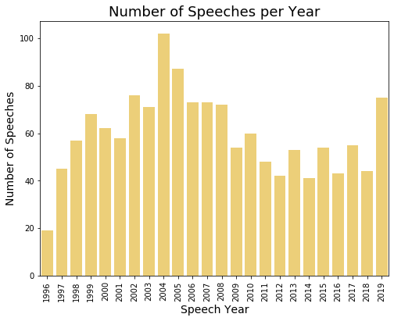
Data acquisition & data Cleaning
FOR EXAMPLE
Source: Federal Reserve Website
Number of Speeches: 1,432
Range of Years: 1996 - 2019 (approx. 60 speeches per year)
Size of speech: Approx. 1800 words
Data Cleaning Process:
Removed punctuation
Removed all numbers
Removed references (where necessary)
Fixed case (all lower case)
Tokenized words (using nltk)
Lemmatized words (using nltk + POS)

Slide 13
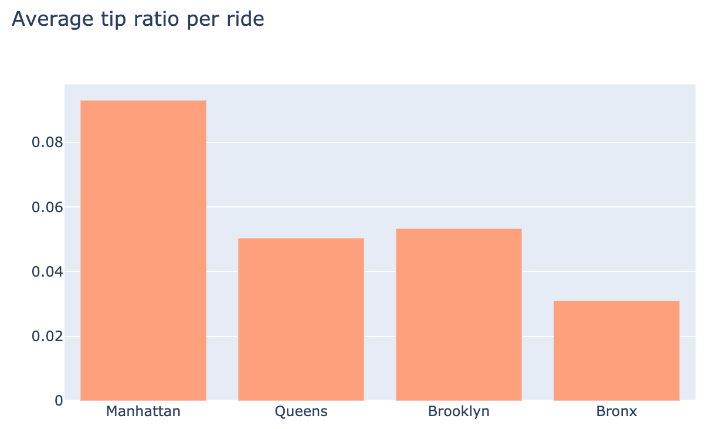
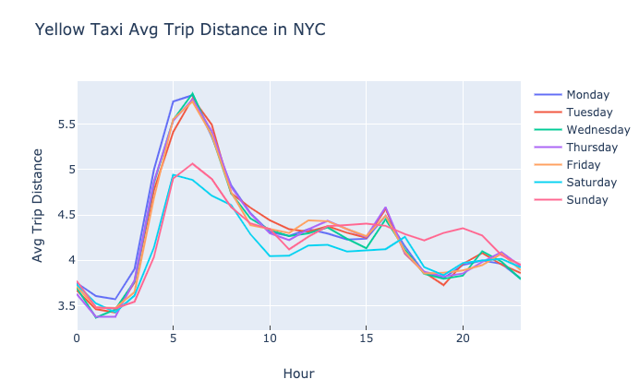
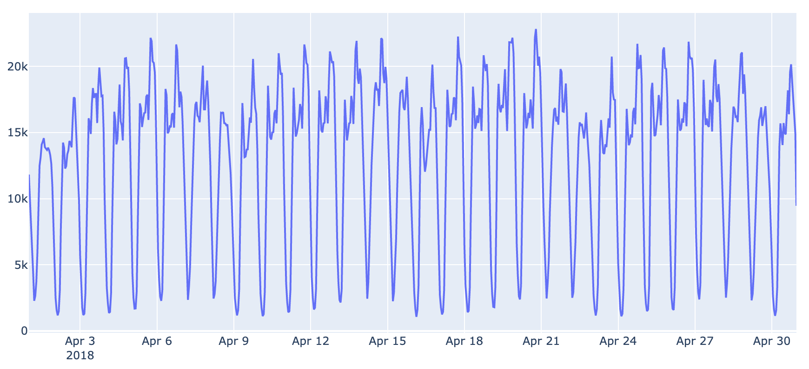
DATASET OVERVIEW
FOR EXAMPLE
Dataset
over 100 millions of taxi pick-ups from 2018
Used Dask for parallel computing on Google Cloud
Average tip ratio per ride
Hourly average trip distance
weekend
Taxi pickup demand in April 2018
High daily and weekly seasonality visible in all of variables

Slide 14
Deep Dive of the Results
You previously gave a preview of your results, now here you can expand.
What evaluation metric did you use to evaluate your model and why?
What led to your best model performance and why?
What were important features in your model and how does this correlate to what you found in EDA?

Slide 15
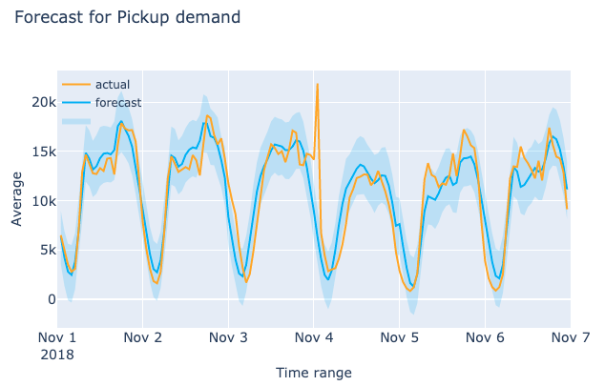
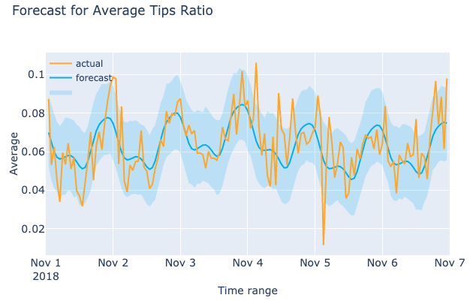
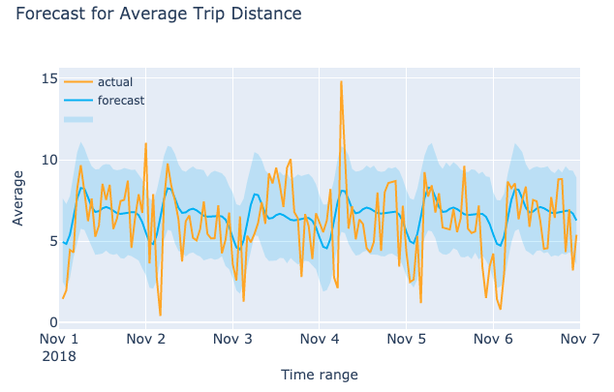
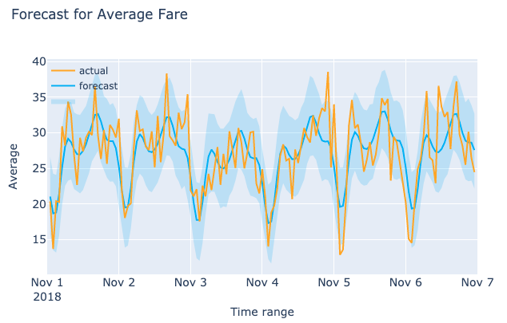
BOROUGH
FINAL MODELS
Manhattan
FOR EXAMPLE
Brooklyn
4 models per borough
16 in total
Staten Island not included
Models fit to data from Jan to Oct 2018
Each model uses a subset of exog variables
Bronx
Queens

Slide 16
Real World Application
How can other people use your model?
You should have thought about this earlier when deciding how to build your model, but now you are explaining in detail how this can be used, and the impact it would have on the users.

Slide 17
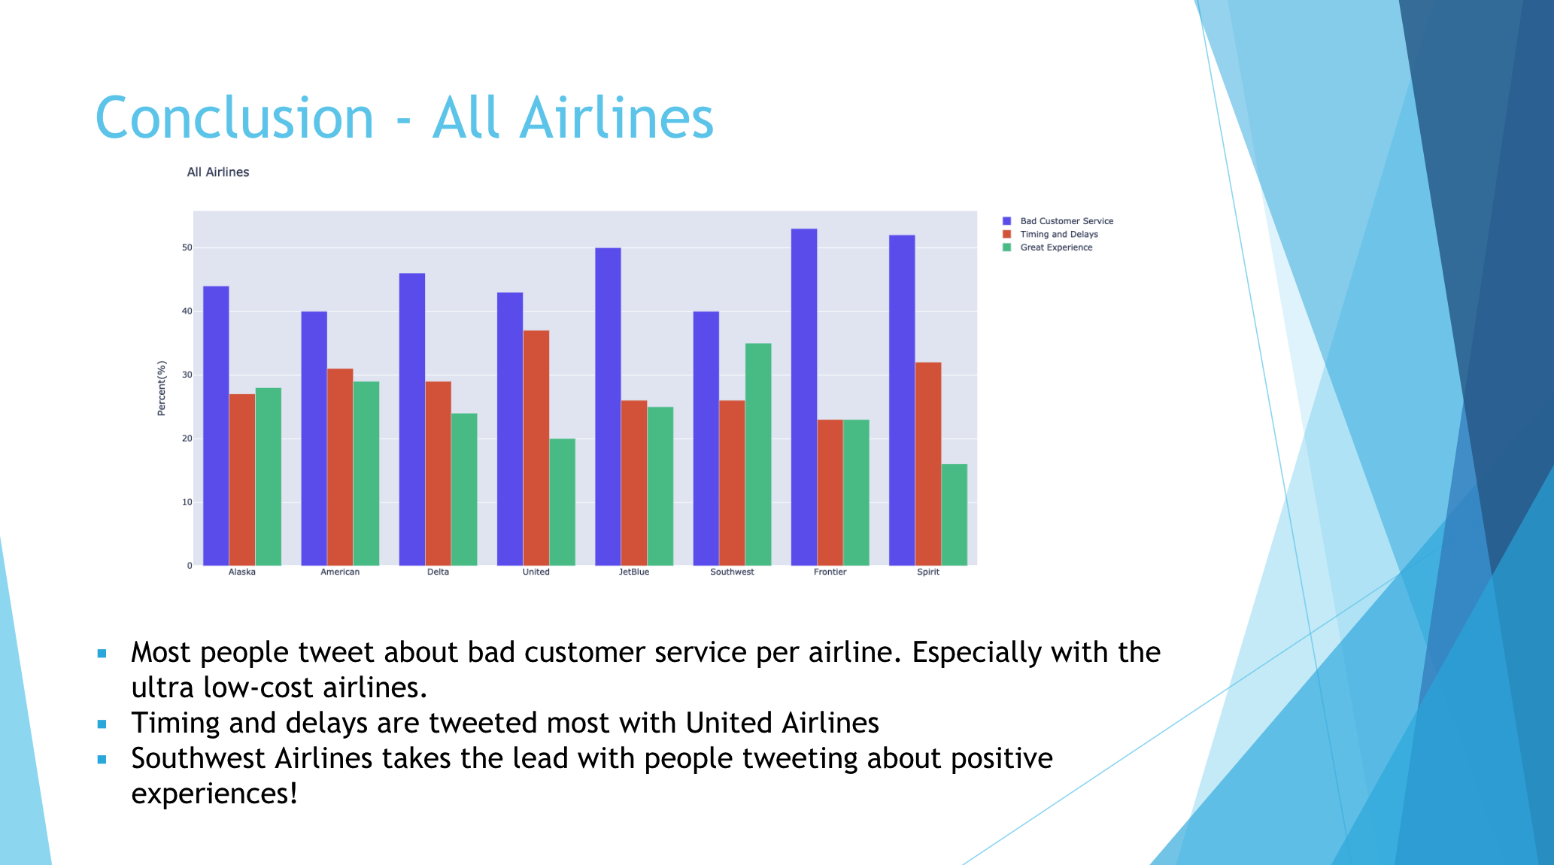
FOR EXAMPLE

Slide 18
Designing Your Slides
People can not effectively read your slides and listen to you at the same time. Are you overloading them with too much to process?
People often become distracted and will drop their attention from your presentation. Does your presentation make it easier for them to engage again?
Presentations are often passed around after the presentation. Can someone pick up your deck and understand it without you being there?

Slide 19
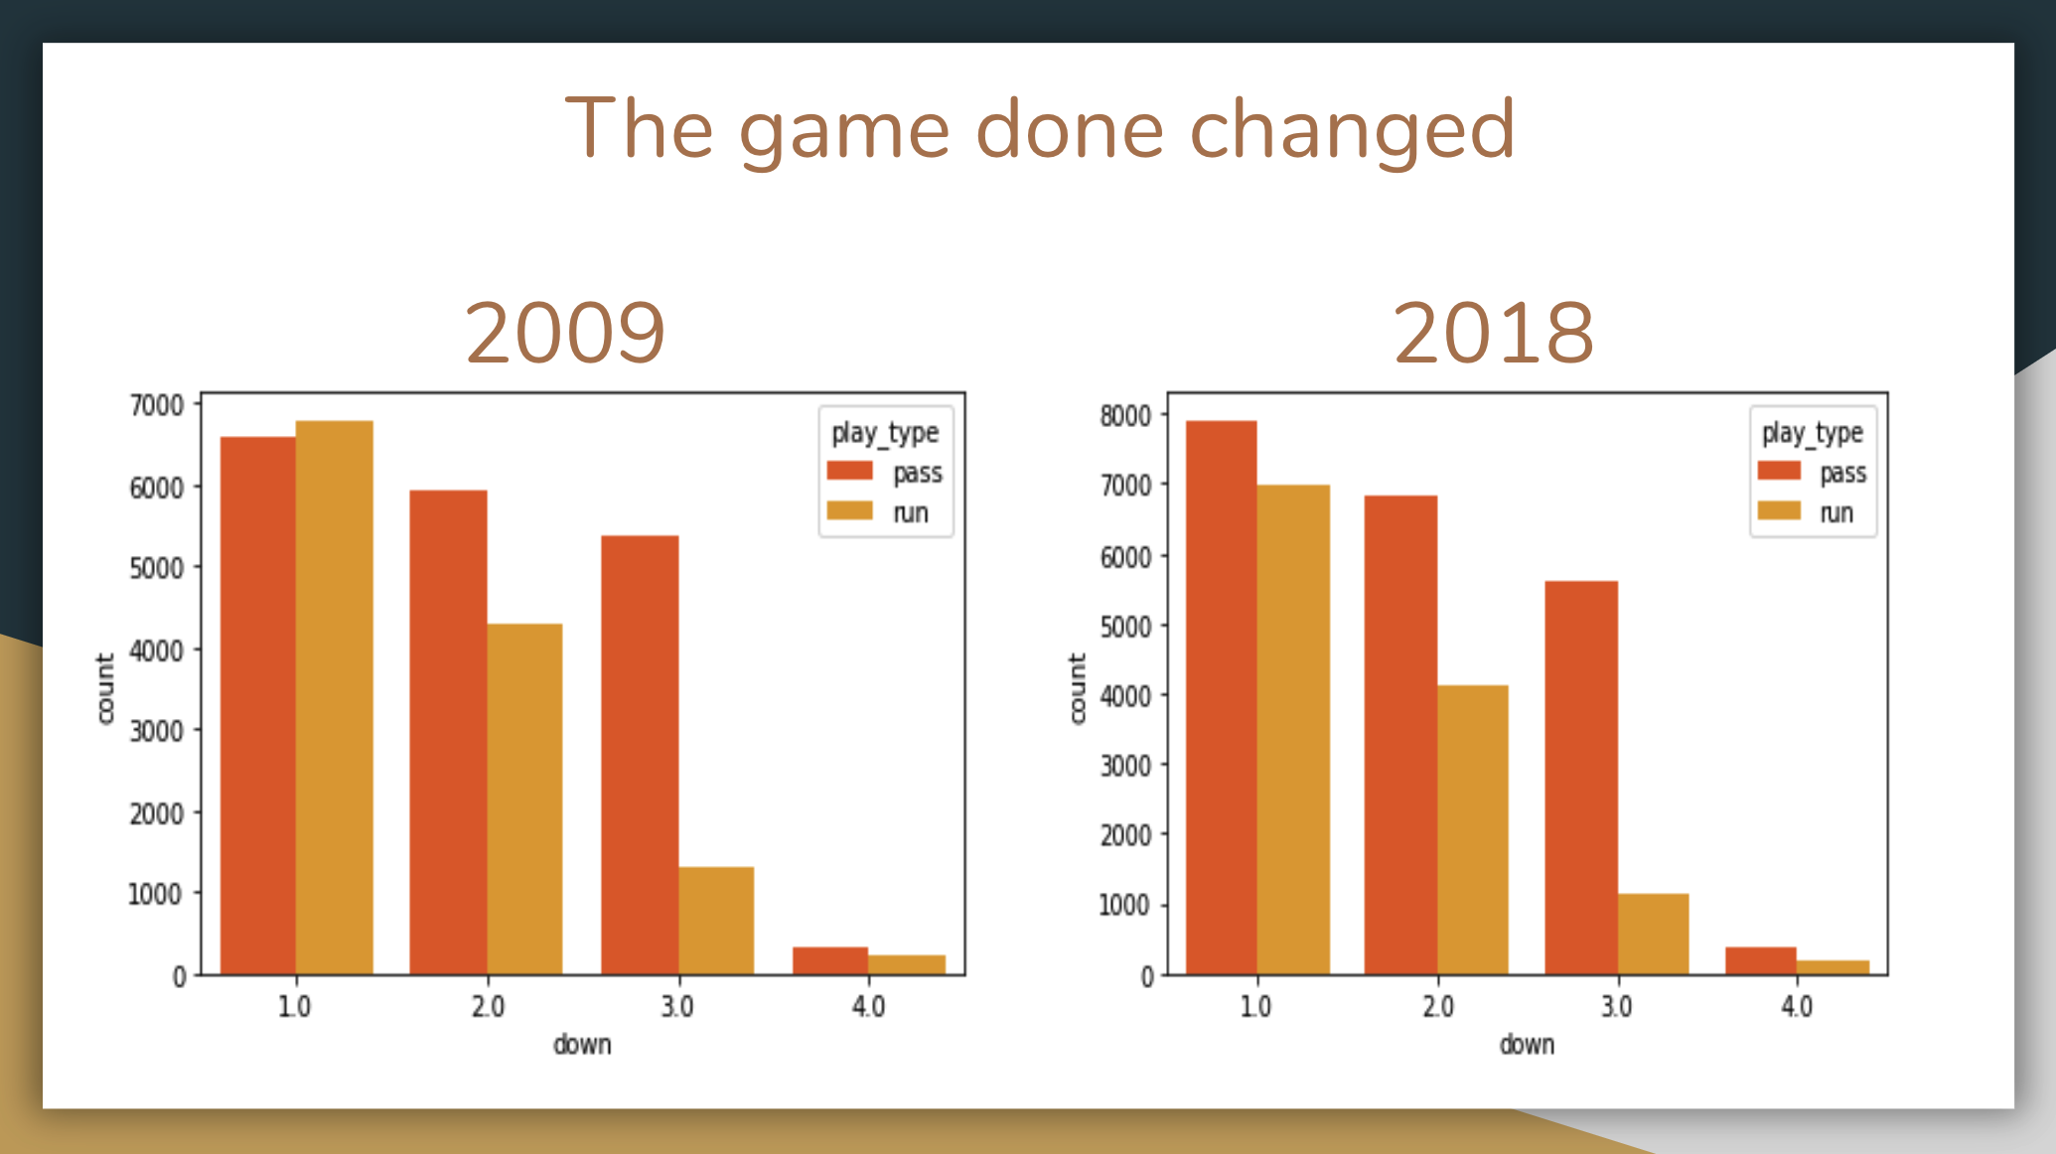
**BAD EXAMPLE**

Slide 20
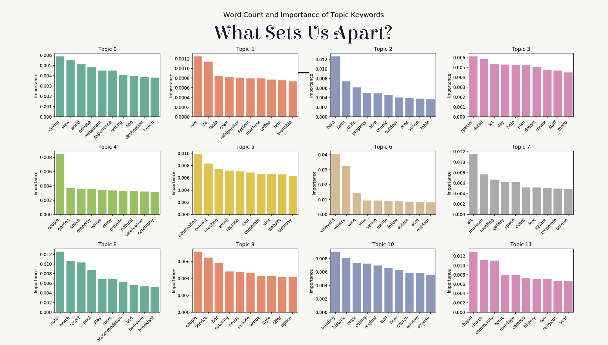
**BAD EXAMPLE**

Slide 21
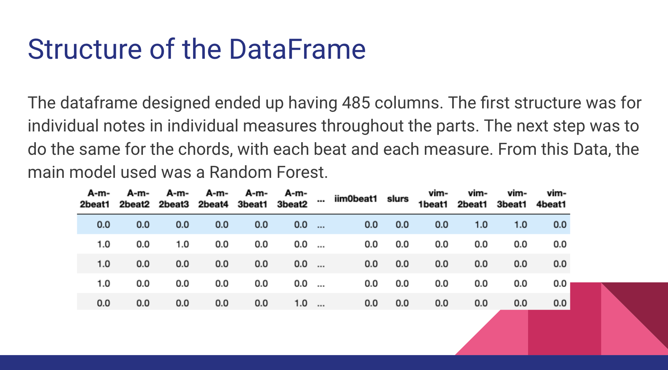
**BAD EXAMPLE**

Slide 22
Application of those ideas
Include a title for each slide.
Do put entire paragraphs on a slide.
A picture is worth a thousand words
Make sure all of your graphs are properly labeled.
Summarize main takeaways from graphics

Slide 23
What to say?
Never read directly from a slide.
Never read a list off that they can easily read.
Just because it took you a lot of time to do, doesn’t mean it should take a lot of time to talk about.
Regularly make eye contact to gauge engagement.
Practice! Practice! Practice!

Slide 24
Student Examples:
https://drive.google.com/file/d/13gIP81APp5hRM4ufGbypwsZV07Cl7n-0/view?usp=sharing
https://docs.google.com/presentation/d/1SCN1Cu5XPjdGhFRlIU3smznJZErrxTeTKIYBNt1rdCA/edit?usp=sharing
https://docs.google.com/presentation/d/1kvOxdc90RDlsaVhWtQxj6WNVOVMHa-Oth7JuEw5pMQM/edit?usp=sharing
https://docs.google.com/presentation/d/10NCW08HXIJ9ZxvuqcVl9WN1EbIxtHWSvZWAbfgiajDk/edit?usp=sharing

